Slide 1
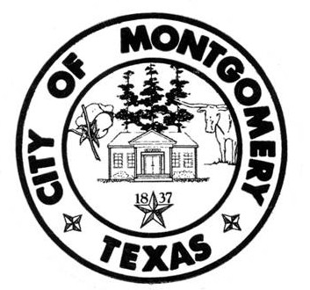
City of Montgomery Texas Preparedness mission
Our mission is to provide programs and activities to City residents and departments to help them prepare for, coping with and recover from the effects of natural and man-made disasters.

Slide 2
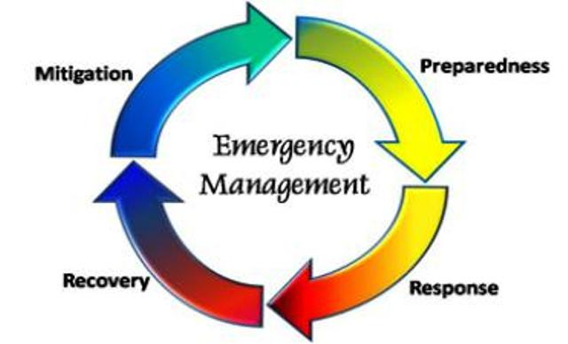
EACH phases of emergency management IS IMPORTANT TO Safety and the recovery after AN EVENT. preparedness, response, recovery and mitigation.

Slide 3
4 phases of emergency management
Preparedness
With Emergency preparedness we create and develop emergency response plans. Preparing before an emergency incident plays a critical role in ensuring that city workers have the necessary equipment, and citizens know where to go, and know how to keep themselves safe when an emergency occurs.
Response
Emergency Response Training for Mass Casualty or any Incidents addresses the response at the operations level for its personnel and volunteers. This training prepares responders on how to utilize the Incident Command System — integrating it into the community emergency response network while dealing with an Emergency during a major incident involving man made or natural disaster
Recovery
After the immediate threats to safety have been addressed and some level of stability has been achieved, the road to recovery begins. And it can last months, years, and even decades. This phase requires strategic planning that addresses the long-term needs of the community, including housing, employment, economic development, infrastructure, and other hefty concerns.
Mitigation
In this early phase, we are concerned with taking steps to make a community less vulnerable to the loss of life and mass destruction in a potential disaster. This might include improvements in public infrastructure, changes in zoning laws, increased regulation, and fireproofing and flood-proofing homes.

Slide 4
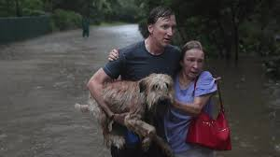
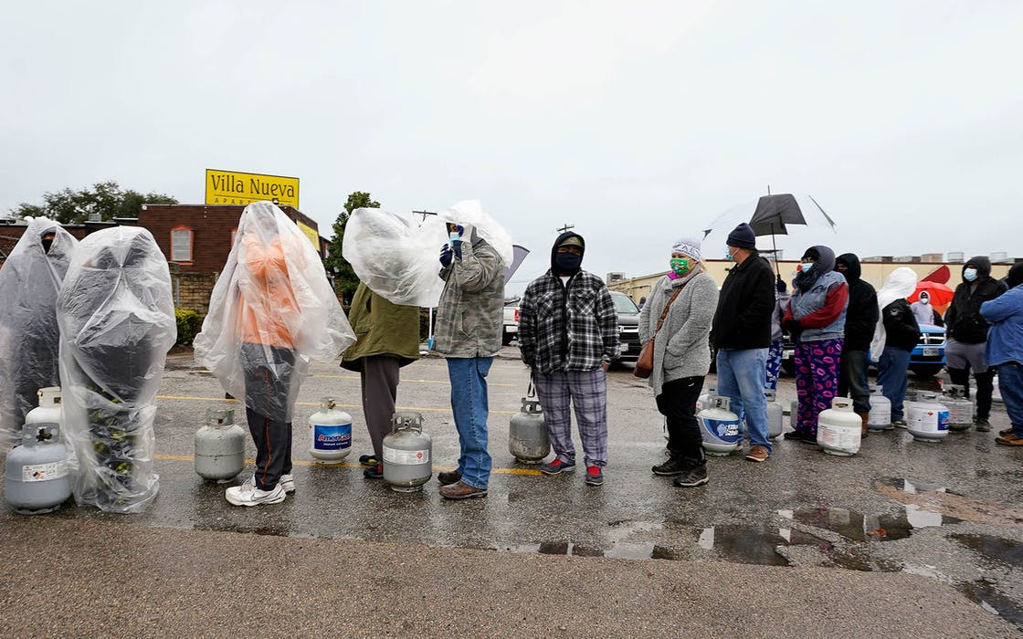
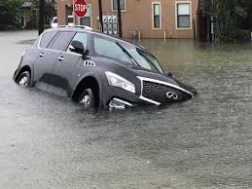
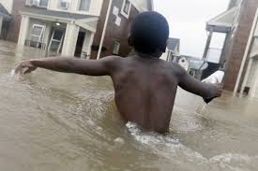
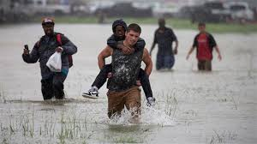
What Harvey and recent weather event taught us was that in a matter of minutes life as we know it can change.

Slide 5
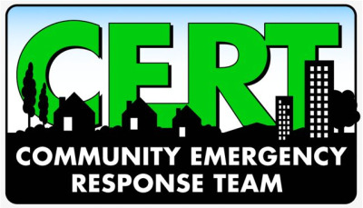
AND that we NEED NOT JUST first responders BUT PEOPLE HELPING PEOPLE

Slide 6
COMMUNITY EMERGENCY RESPONSE TEAM
The Community Emergency Response Team (CERT) program educates volunteers about disaster preparedness for the hazards that may impact their area and trains them in basic disaster response skills, such as fire safety, light search and rescue, team organization, and disaster medical operations.

Slide 7
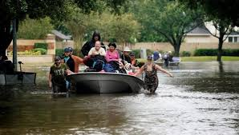
Join us
Your community needs you

